Slide 1
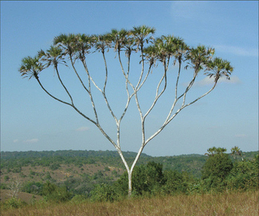

Part-C
Trees
Trees
Notes:
Trees
115/11/07 08:48

Slide 2

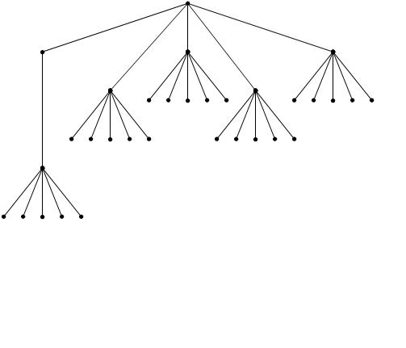
Pyramid Scheme
Trees

Slide 3
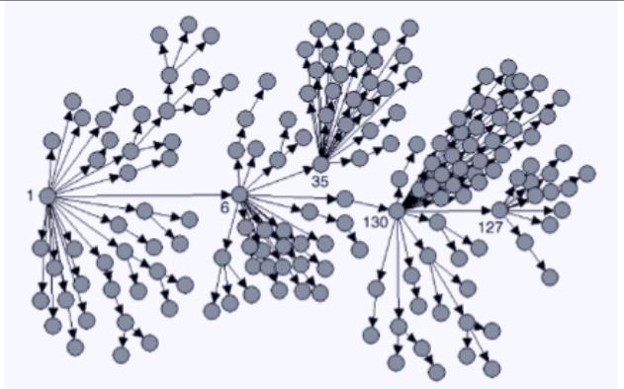
Infection network of SARS (Singapore)
Trees

Slide 4
University
Fac. of
Sci. & Eng.
Bus. School
Law School
CS Dept.
EE Dept.
Math. Dept.
Trees
Notes:
Trees
115/11/07 08:48

Slide 5
What is a Tree
In computer science, a tree is an abstract model of a hierarchical structure
A tree consists of nodes with a parent-child relation
Applications:
  Organization charts
  File systems
  arithmetic expression
Computers”R”Us
Sales
Manufacturing
R&D
US
International
Laptops
Desktops
Europe
Asia
Canada
Remark: A tree is a special kind of graph, where there is not circuit.
Trees

Slide 6
File System on Computers
H:
CS5302
CS5301
Others
net
source
a.java
b.java
readme
Node.java
Stack.java
Trees

Slide 7
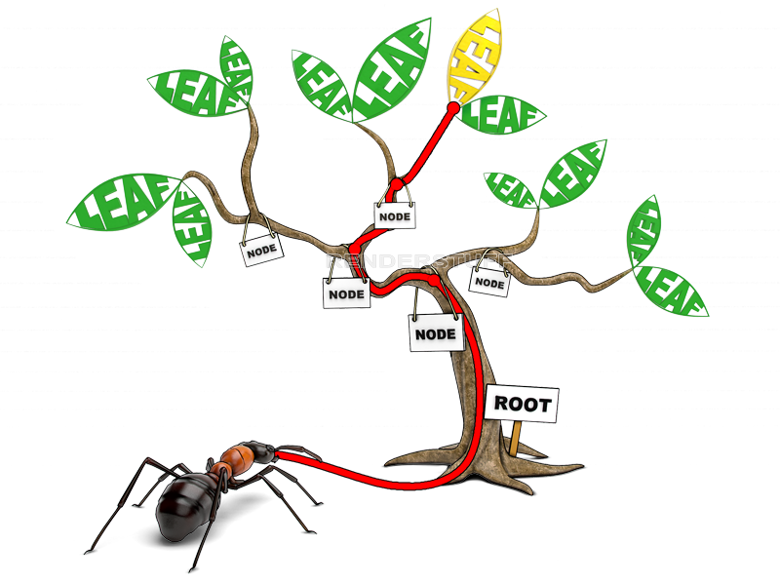
Trees

Slide 8
Tree Terminology
Root: node without parent (e.g. A)
Internal node: node with at least one child (e.g. A, B, C, F)
External node (or leaf ): node without children (E, I, J, K, G, H, D)
Ancestors of a node: parent, grandparent, grand-grandparent, etc.
Depth of a node: number of ancestors
Height of a tree: maximum depth of any node (3)
Descendant of a node: child, grandchild, grand-grandchild, etc.
Subtree: tree consisting of a node and its descendants
A
subtree
B
C
D
E
F
G
H
I
J
K
Trees

Slide 9
Tree Terminology
Ordered tree:There is a linear ordering defined for the children of each node.
Example: The order among siblings are from left to right.
Ch1 Ch2 Ch3;
S1.1 S1.2;
S2.1 S2.1;
1.2.1 1.2.2 1.2.3;
Book
Ch1
Ch2
Ch3
S.1.1
S.1.2
S.2.1
S.2.2
1.2.1
1.2.2
1.2.3
Trees

Slide 10
Tree ADT (§ 6.1.2)
A set of nodes with parent-child relationship.
Generic methods:
  integer size()
  boolean isEmpty()
Accessor methods:
  root() returns the tree’s root.
  parent(p) returns p’s parent
  children(p) returns an iterator of the children of node v.
  Element() return the object stored on this node.
Query methods:
  boolean isInternal(p)
  boolean isExternal(p)
  boolean isRoot(p)
Update method:
  object replace (p, o): replace the content of node p with o.
Additional update methods may be defined by data structures implementing the Tree ADT
Trees

Slide 11
Binary Trees (§ 6.3)
A binary tree is a tree with the following properties:
  Each internal node has at most two children (exactly two for proper binary trees)
  The children of a node are an ordered pair
We call the children of an internal node left child and right child
Alternative recursive definition: a binary tree is either
  a tree consisting of a single node, or
  a tree whose root has an ordered pair of children, each of which is a binary tree
Applications:
  arithmetic expressions
  decision processes
  searching
A
B
C
D
E
F
G
H
I
Trees

Slide 12
Arithmetic Expression Tree
Binary tree associated with an arithmetic expression
  internal nodes: operators
  external nodes: operands
Example: arithmetic expression tree for the expression (2 × (a − 1) + (3 × b))
+
×
×
2
−
3
b
a
1
Trees

Slide 13
Decision Tree
Binary tree associated with a decision process
  internal nodes: questions with yes/no answer
  external nodes: decisions
Example: drinking decision
Want to drink ?
No
Yes
How about coffee?
Bye-Bye
No
Yes
Here it is
How about tee
No
Yes
No
Here it is
Here is your water
Trees

Slide 14
BinaryTree ADT (§ 6.3.1)
The BinaryTree ADT extends the Tree ADT, i.e., it inherits all the methods of the Tree ADT
Additional methods:
  position left(p)
  position right(p)
  boolean hasLeft(p)
  boolean hasRight(p)
Update methods may be defined by data structures implementing the BinaryTree ADT
Trees

Slide 15
Inorder Traversal (just for binary tree)
In an inorder traversal a node is visited after its left subtree and before its right subtree
6
Algorithm inOrder(v)
  if hasLeft (v)
    inOrder (left (v))
  visit(v)
  if hasRight (v)
    inOrder (right (v))
2
8
1
4
7
9
3
5
Trees

Slide 16
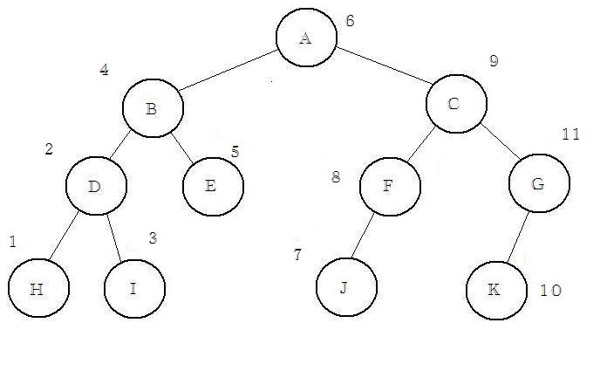
Inorder Traversal (Another example)
The number on a node is smaller than the numbers on its Right sub-tree and larger than the numbers on it left sub-tree.
7
Trees

Slide 17
InOrder Traversal (Another example)
8
4
12
2
6
14
10
1
3
5
9
11
15
7
13
Trees

Slide 18
Print Arithmetic Expressions
Specialization of an inorder traversal
  print operand or operator when visiting node
  print “(“ before traversing left subtree
  print “)“ after traversing right subtree
Algorithm printExpression(v)
  if hasLeft (v)
  print(“(’’)
    printExpression (left(v))
  print(v.element ())
  if hasRight (v)
    printExpression (right(v))
  print (“)’’)
+
×
×
2
−
3
b
((2 × (a − 1)) + (3 × b))
a
1
Trees

Slide 19
Print Arithmetic Expressions
-
+
10
+
x
×
×
2
−
3
b
a
1
((x+((2 × (a − 1)) + (3 × b)))-10)
Trees

Slide 20
Preorder Traversal
A traversal visits the nodes of a tree in a systematic manner
In a preorder traversal, a node is visited before its descendants
Application: print a structured document
Algorithm preOrder(v)
  visit(v)
  for each child w of v
  preorder (w)
1
Make Money Fast!
2
5
9
1. Motivations
2. Methods
References
3
4
6
7
8
1.1 Greed
1.2 Avidity
2.1 Stock
Fraud
2.2 Ponzi
Scheme
2.3 Bank
Robbery
Trees

Slide 21
Preorder Traversal (Another example)
Visit the node.
Visit the sub-trees rooted by its children one by one.
Algorithm preOrder(v)
  visit(v)
  for each child w of v
  preorder (w)
1
2
17
9
3
6
14
10
13
4
5
7
11
12
16
8
15
Trees

Slide 22
Postorder Traversal
In a postorder traversal, a node is visited after its descendants
Application: compute space used by files in a directory and its subdirectories
Algorithm postOrder(v)
  for each child w of v
  postOrder (w)
  visit(v)
9
cs16/
8
3
7
homeworks/
programs/
todo.txt
1K
1
2
4
5
6
h1c.doc
3K
h1nc.doc
2K
DDR.java
10K
Stocks.java
25K
Robot.java
20K
Trees

Slide 23
Postorder Traversal (Another example)
.
My explanation:
If the reached node is a leaf, then visit it.
When a node is visited, visit the sub-tree rooted by its sibling on the right.
When the rightmost child is visited, visit its parent.
Algorithm postOrder(v)
  for each child w of v
  postOrder (w)
  visit(v)
17
7
16
15
3
6
14
10
11
1
2
4
8
9
13
5
12
Trees

Slide 24
Evaluate Arithmetic Expressions
Specialization of a postorder traversal
  recursive method returning the value of a subtree
  when visiting an internal node, combine the values of the subtrees
Algorithm evalExpr(v)
  if isExternal (v)
    return v.element ()
  else
  x ← evalExpr(leftChild (v))
  y ← evalExpr(rightChild (v))
  ◊ ← operator stored at v
    return x ◊ y
+
×
×
2
−
3
2
5
1
Trees

Slide 25
Array-Based Representation of Binary Trees
nodes are stored in an array
1
A
…
2
3
B
D
let rank(node) be defined as follows:
  rank(root) = 1
  if node is the left child of parent(node), rank(node) = 2*rank(parent(node))
  if node is the right child of parent(node), rank(node) = 2*rank(parent(node))+1
4
5
6
7
E
F
C
J
10
11
G
H
Trees

Slide 26
Full Binary Tree
A full binary tree:
  All the leaves are at the bottom level
  All nodes which are not at the bottom level have two children.
  A full binary tree of height h has 2^{h} leaves and 2^{h}-1 internal nodes.
1
3
2
4
5
6
7
This is not a full binary tree.
A full binary tree of height 2
Trees

Slide 27
Properties of Proper Binary Trees
Notation
  n number of nodes
  e number of external nodes
  i number of internal nodes
  h height
Properties for proper binary tree:
  e = i + 1
  n = 2e − 1
  h ≤ i
  e ≤ 2^{h}
  h ≥ log₂ e
1
3
2
6
7
No need to remember.
14
15
Trees

Slide 28
Depth(v): no. of ancestors of v
Algorithm depth(T,v)
  If T.isRoot(v) then return 0;
  else
  return 1+depth(T, T.parent(v))
0
Make Money Fast!
1
1
1
1. Motivations
2. Methods
References
2
2
2
2
2
1.1 Greed
1.2 Avidity
2.1 Stock
Fraud
2.2 Ponzi
Scheme
2.3 Bank
Robbery
Trees

Slide 29
Height(T): the height of T is max depth of an external node
Algorithm height1(T)
h=0;
  for each v∈T.positions() do
  if T.isExternal(v) then h=max(h, depth(T, v))
  return h
T.positions() holds all nodes in T. See the method in LinkedBinaryTree.java. The max is 2.
0
Make Money Fast!
1
1. Motivations
2. Methods
1
2.1 Stock
Fraud
2.2 Ponzi
Scheme
2.3 Bank
Robbery
2
2
2
2
1.1 Greed
1.2 Avidity
2
Trees

Slide 30
Height(T,v):
If v is an external node, then height of v is 0.
Otherwise, the height of v is one +max height of a child of v.
Algorithm height2(T,v)
  if T.isExternal(v) then return 0
  else
  h=0
  for each w∈T.children(v) do
  h=max(h, height2(T, w))
  return 1+h
Trees

Slide 31
Height(T,v):
Algorithm height2(T,v)
  if T.isExternal(v) then return 0
  else
  h=0
  for each w∈T.children(v) do
  h=max(h, height2(T, w))
  return 1+h
2
Make Money Fast!
1
1
1
1. Motivations
2. Methods
References
0
0
0
0
0
1.1 Greed
1.2 Avidity
2.1 Stock
Fraud
2.2 Ponzi
Scheme
2.3 Bank
Robbery
Trees

